Slide 1
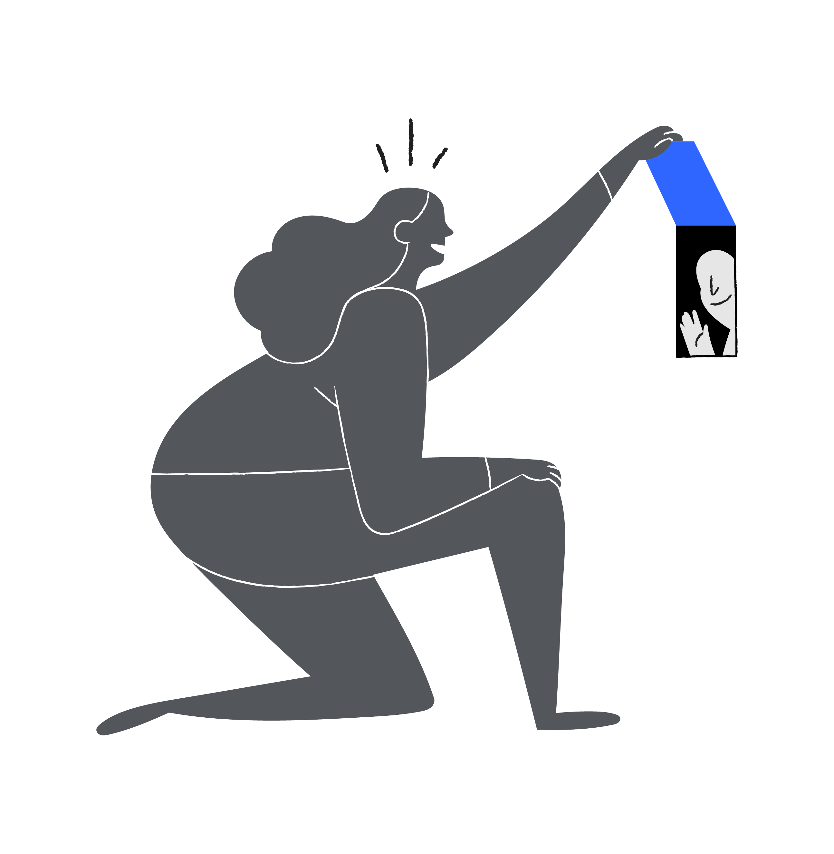
TBD: Implementation of Large Language Models
7/21/2023
Notes:
Start with the Demo/App. Then go to what is going on behind the scenes.

Slide 2
Table of Contents
Sections
Introduction
Demonstration
Solution Design and Implementation
Value of Productionalization
Notes:
DEMO Questions:
What is this person’s BMI?
Does this person drink alcohol?
Does this person use tobacco?
Does this person use smokeless tobacco?
When did they report tobacco?

Slide 3

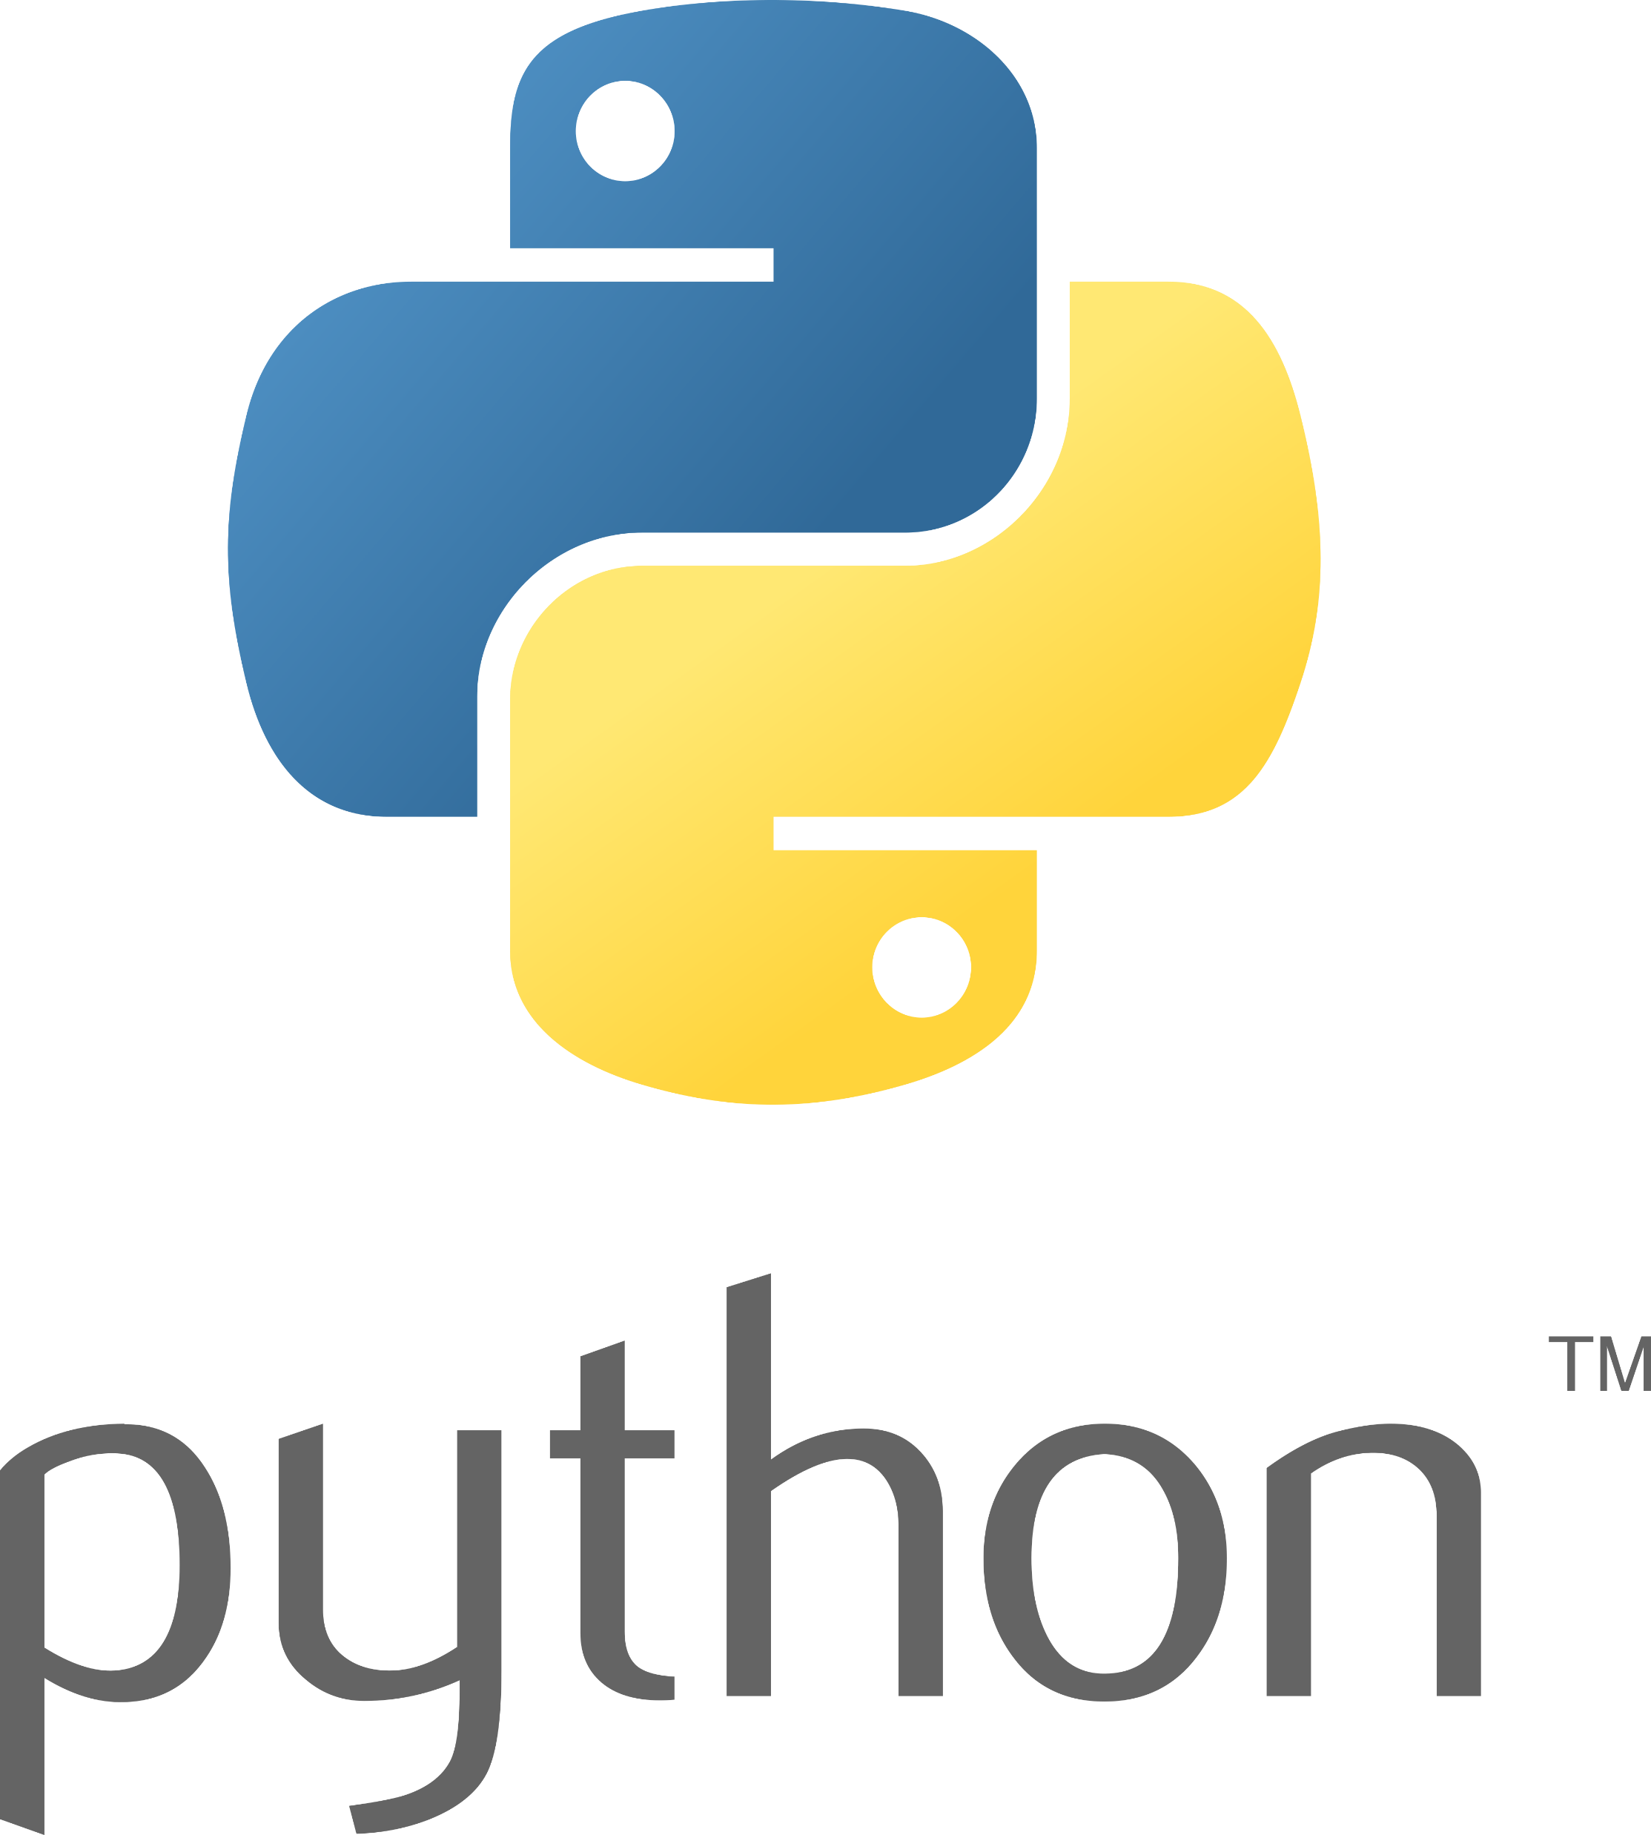


Solution Design and Implementation
Open-source python package to build beautiful apps quickly
App
Public Service Announcement
Important Consideration
Review the license the software was open-sourced under
Review the data the model was trained on
Would Thrivent be comfortable with the data source?
Are the data sources open to commercial use?
Reach out to discuss other considerations!
Extract Text
AI Component
Open-source python package to extract text from PDFs
Pre-trained model open-sourced by Microsoft
This is a fixed model (it doesn’t learn from data you send to it)
It is physically located on local resources (no calls to the outside)
Tesseract OCR tool opened sourced by Google
Notes:
How its done
Risks associated and how those are addressed
OCR = optical character recognition
Model
Pre-Trained Open Source
Forgetful Fixed Equation
Created by Microsoft
Data does not leave Thrivent
Data sent and received is internal
Pulls Out Exact Quotes

Slide 4

Value of Productionalization
Known Issues with EHRs
EHRs average 75 pages in length
Underwriter Time (30-45mins per EHR)
Known for having duplicative information
Majority of information not relative to underwriting
1-2 per Day per Underwriter
Additional Use Cases
Reviewing APS in Claims Area
Process Documents
Notes:
NATHAN

Slide 5
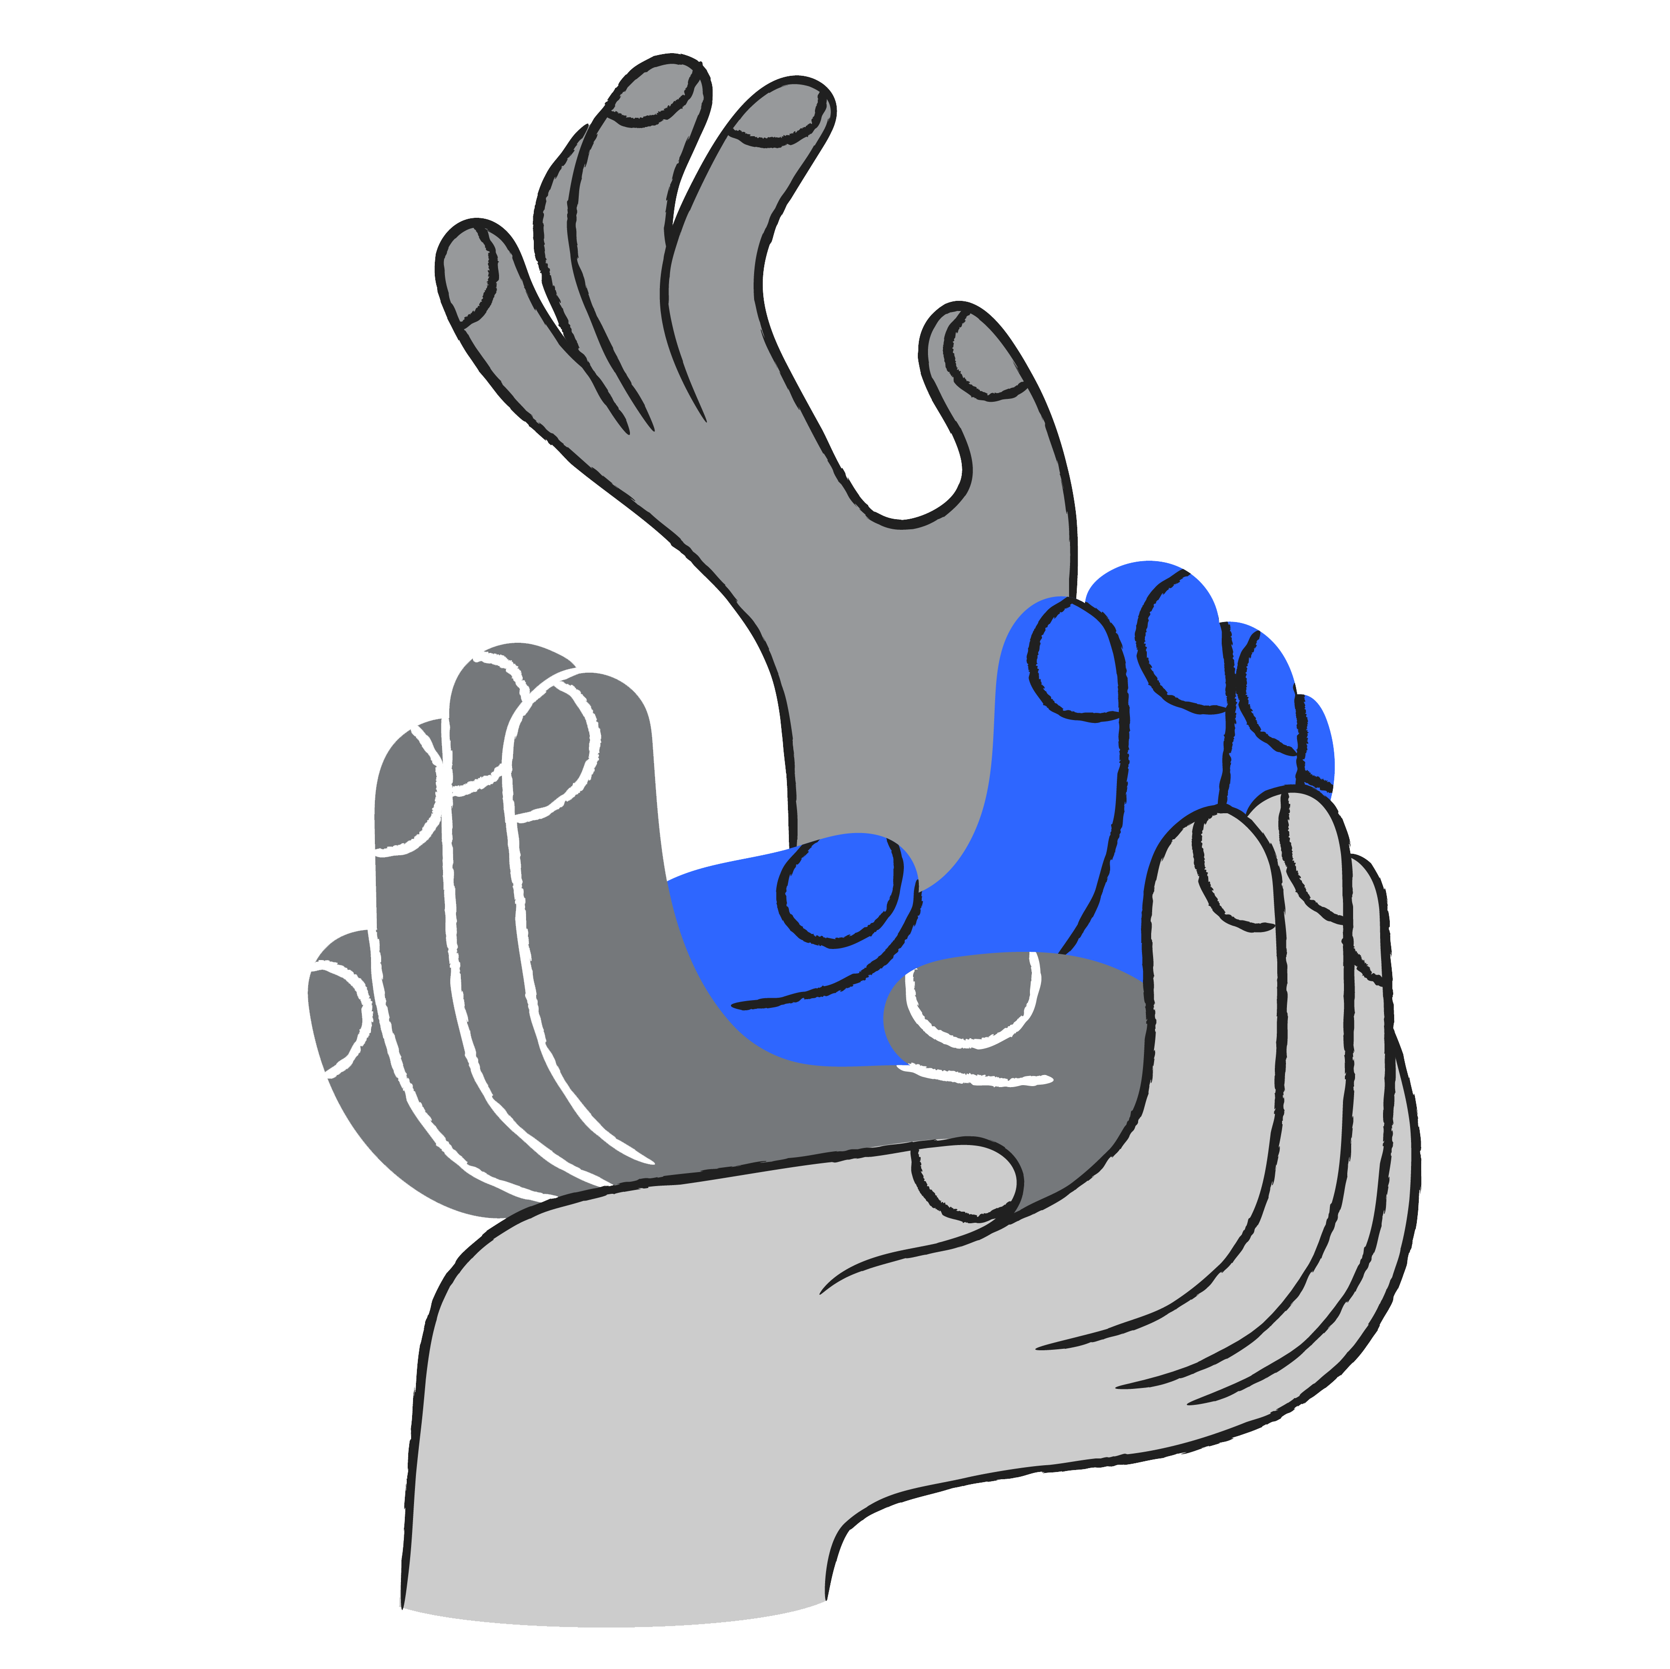



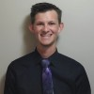
Thank you
Our Team
Jared Bailey
Sr. Data Scientist
Ryan Knitter
Sr. Data Scientist
Jon Raether
BI Analyst
Nathan Steckman
Staff Actuary I

